Slide 1

Video Game Sales
Data Project – Group 4:
Teresa Le, Sean Milligan, Brennan Berardo, Yining Jin

Slide 2




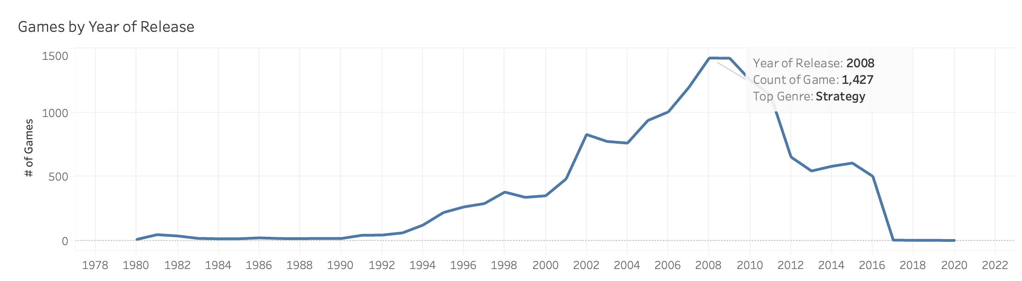
Project Overview
16,717 Games
12 Genres
1980 - 2020
Best Selling Game
Wii Sports

Slide 3
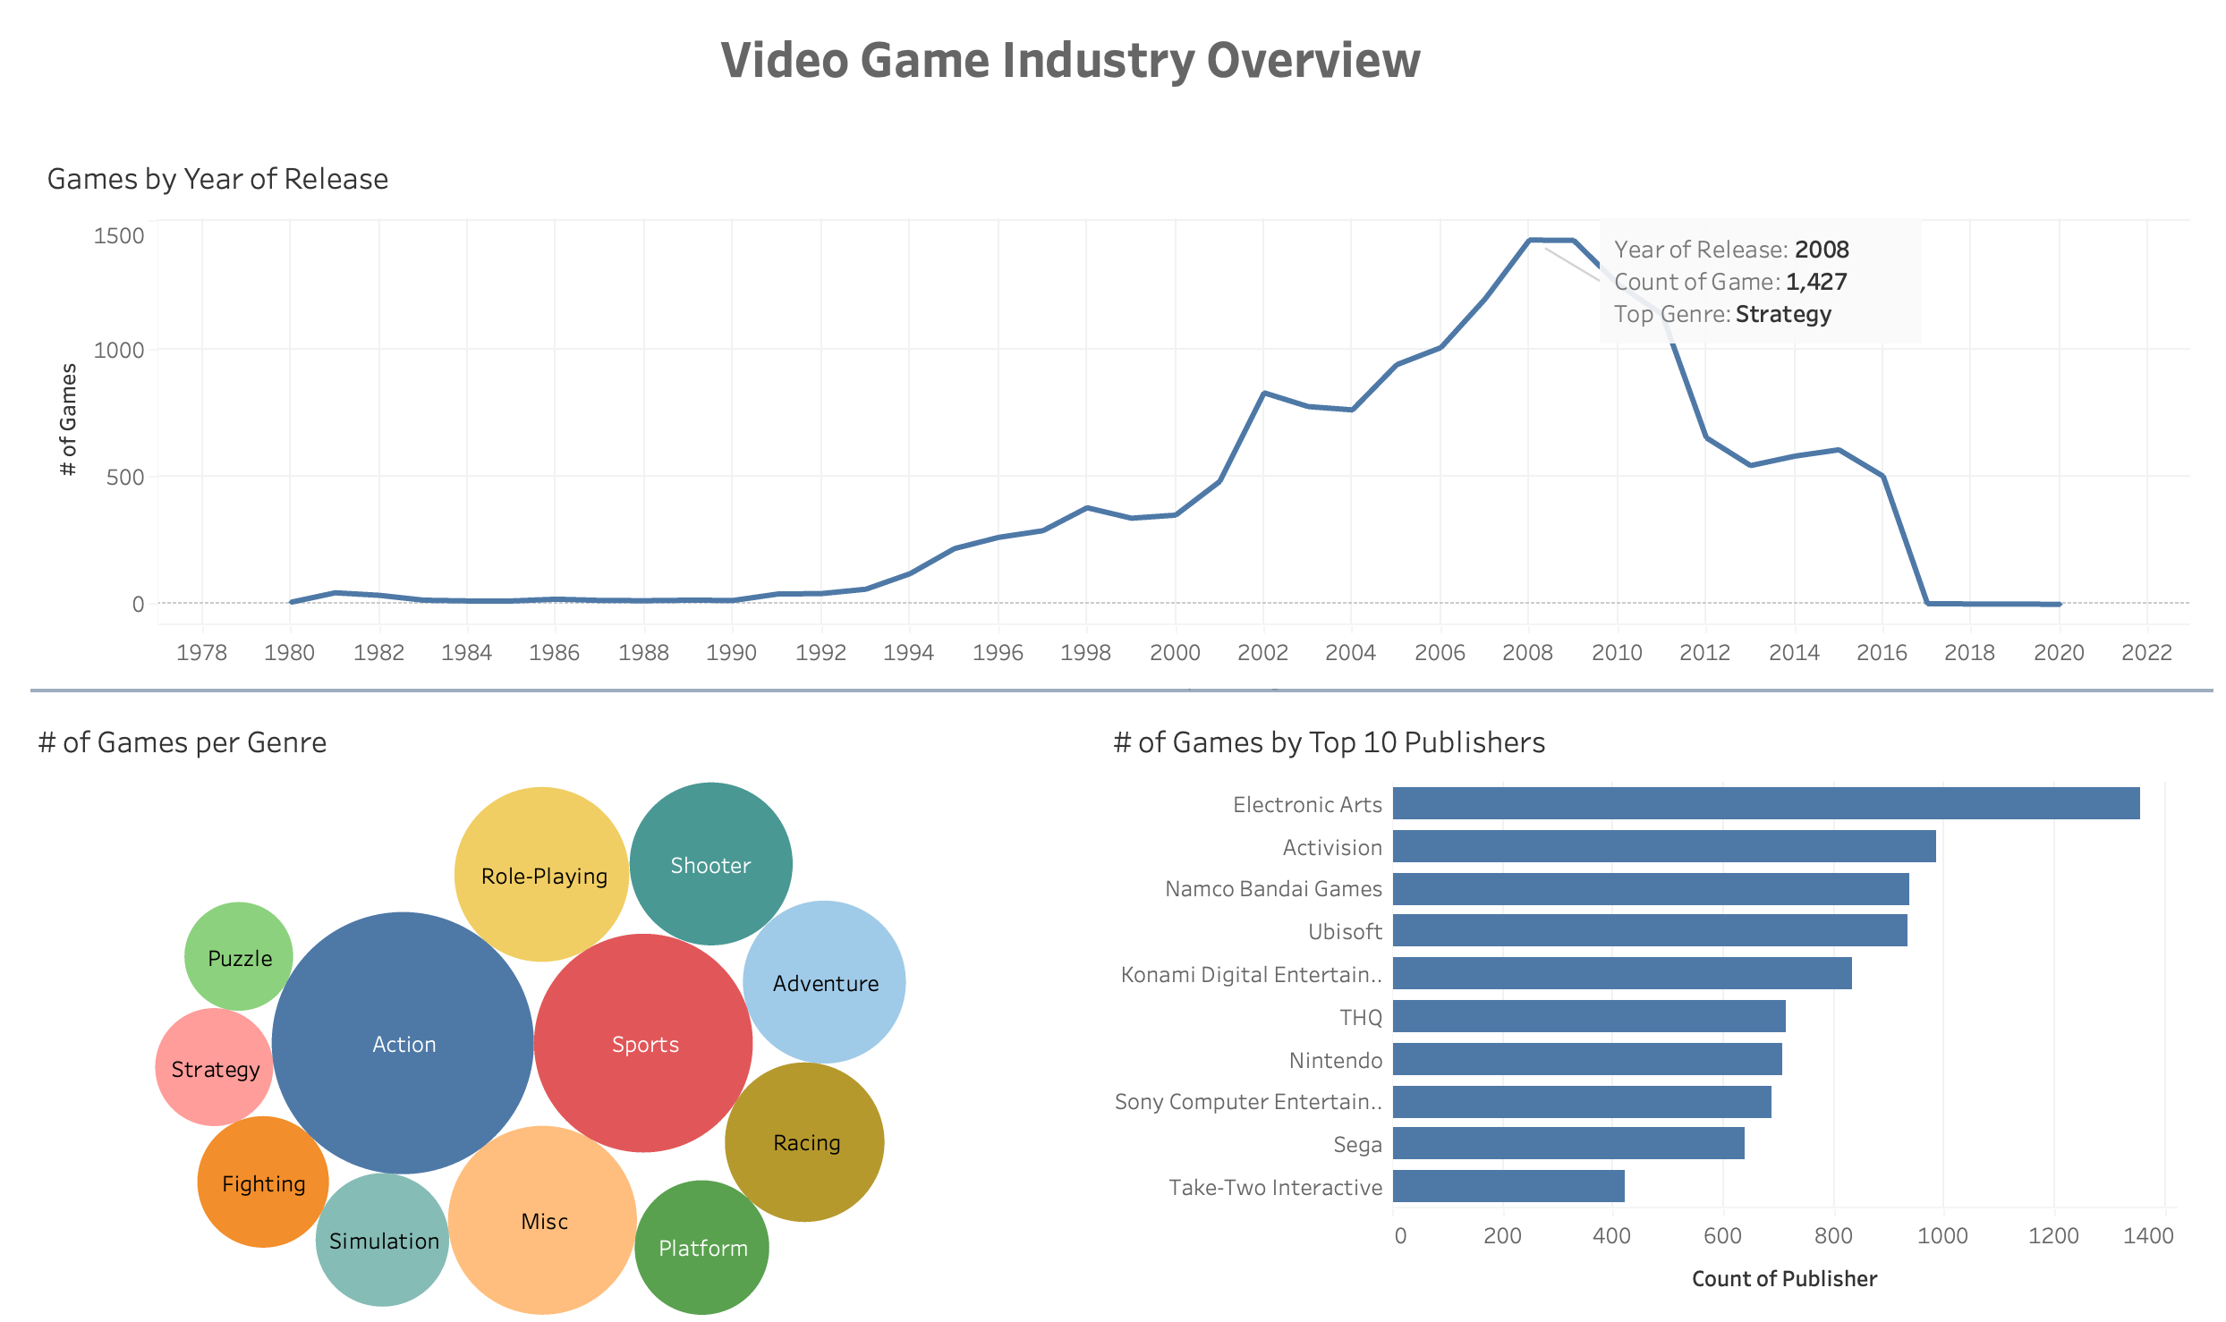
Dashboard

Slide 4
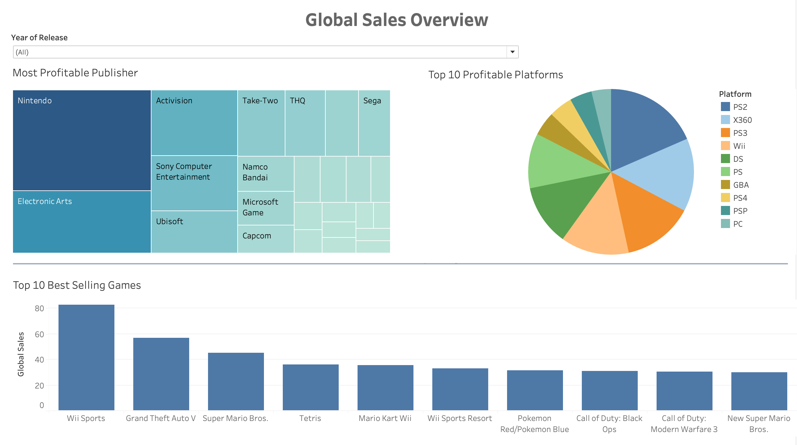
Dashboard

Slide 5
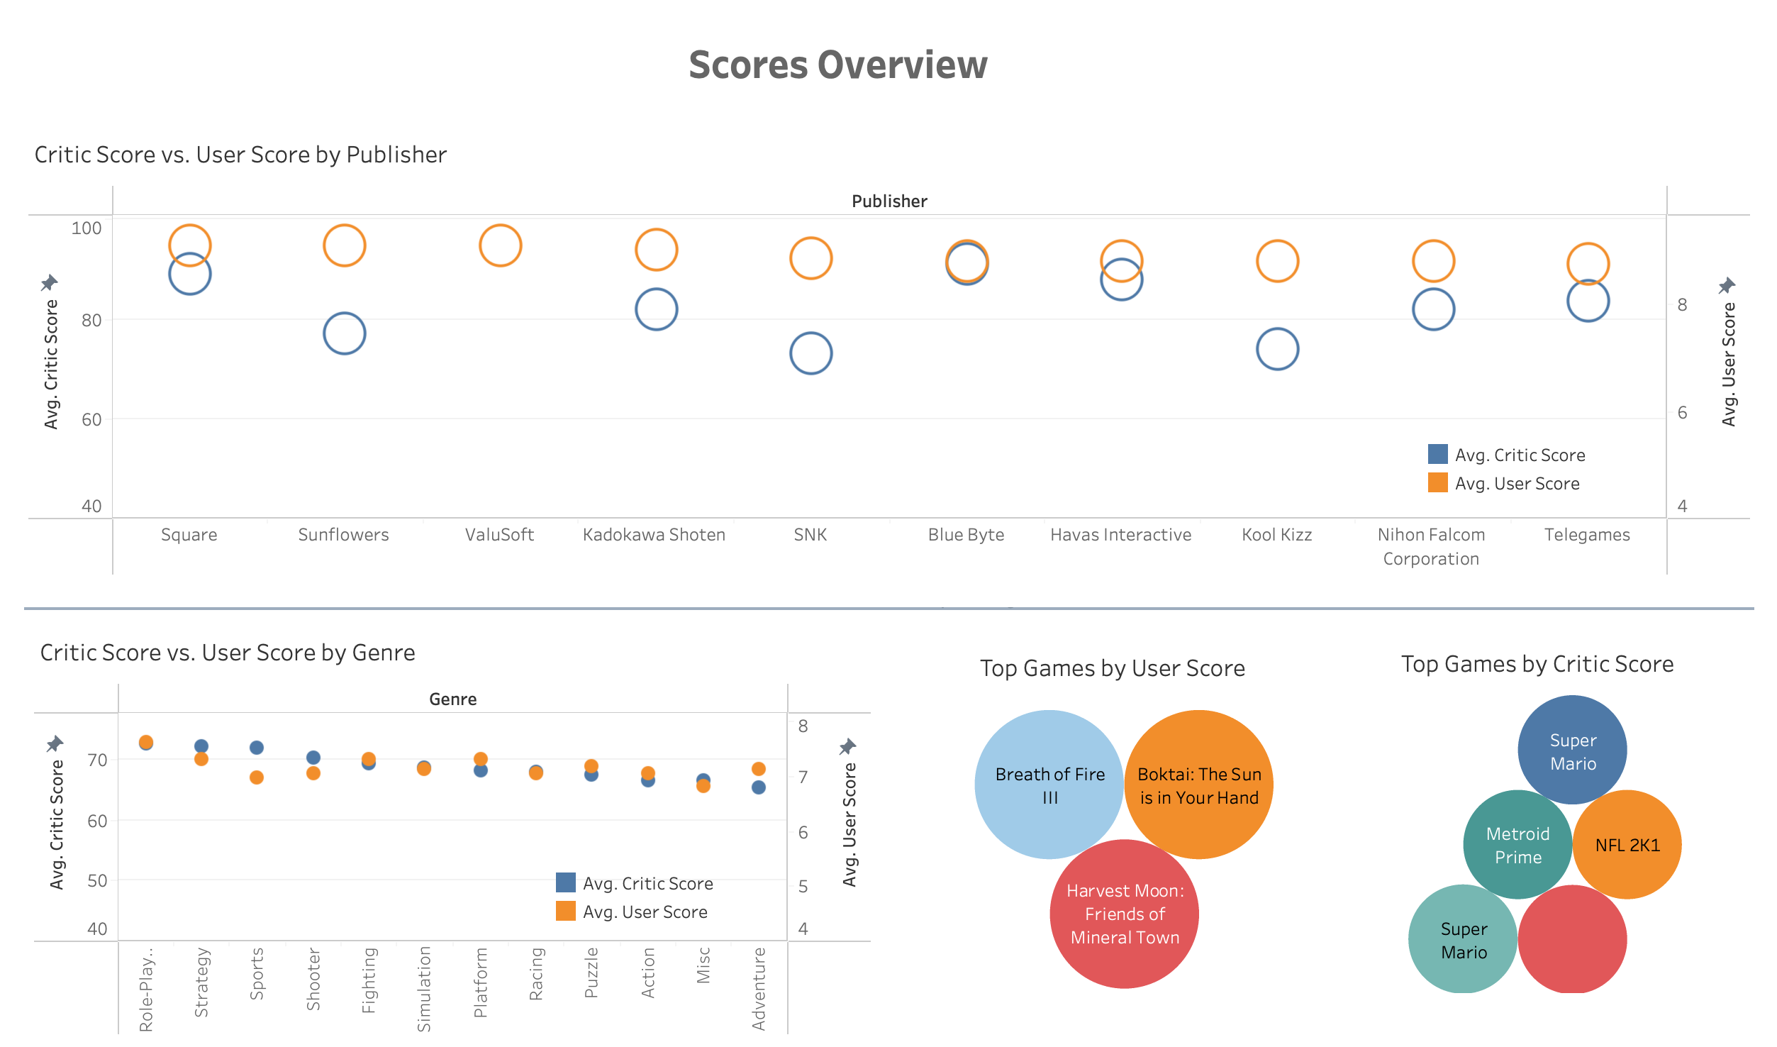
Dashboard

Slide 6
Purpose
Can we predict global revenues within the first year of a new game's release?
Discover the key features for revenue predictions
Is there a direct connection between score, rating, & sales?

Slide 7

Methodology
Technologies Used:
Tableau
SQL
PgAdmin
Python
R
MORE Python

Slide 8
Cleaning the Data
Remove rows with null values
"Unexpected" problematic data
Change column data types
Create New Columns
Remove columns: Critic count, User count, Developer, Year_of_Release
Normalization: Critic score, Sales (Globally and by region)
Assumption: 80% of revenue comes from 1st year of sales
REGRESSION PREPARATION:
Binning of categorical variables
Coding of categorical variables using the one_hot_encoder

Slide 9
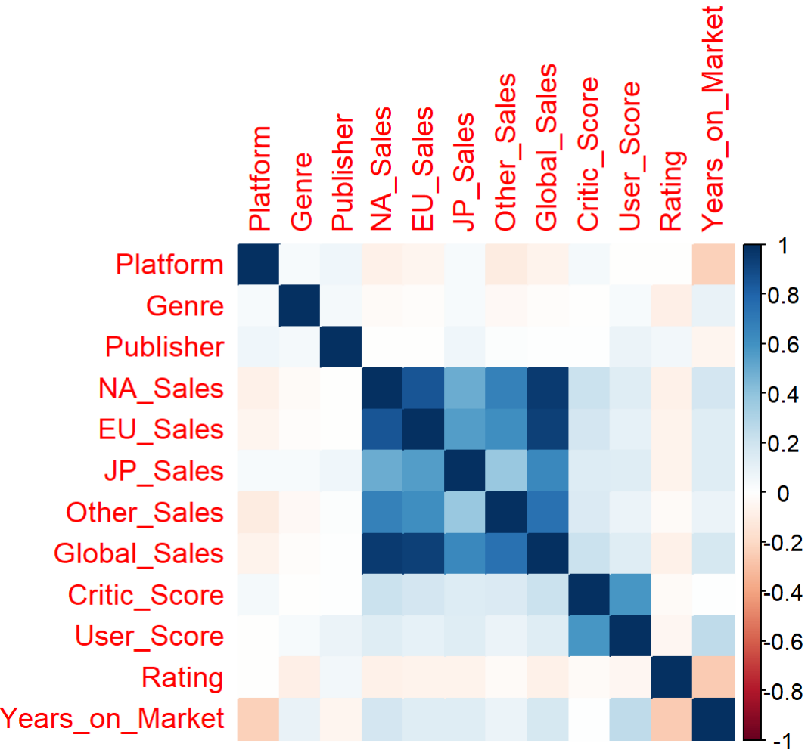
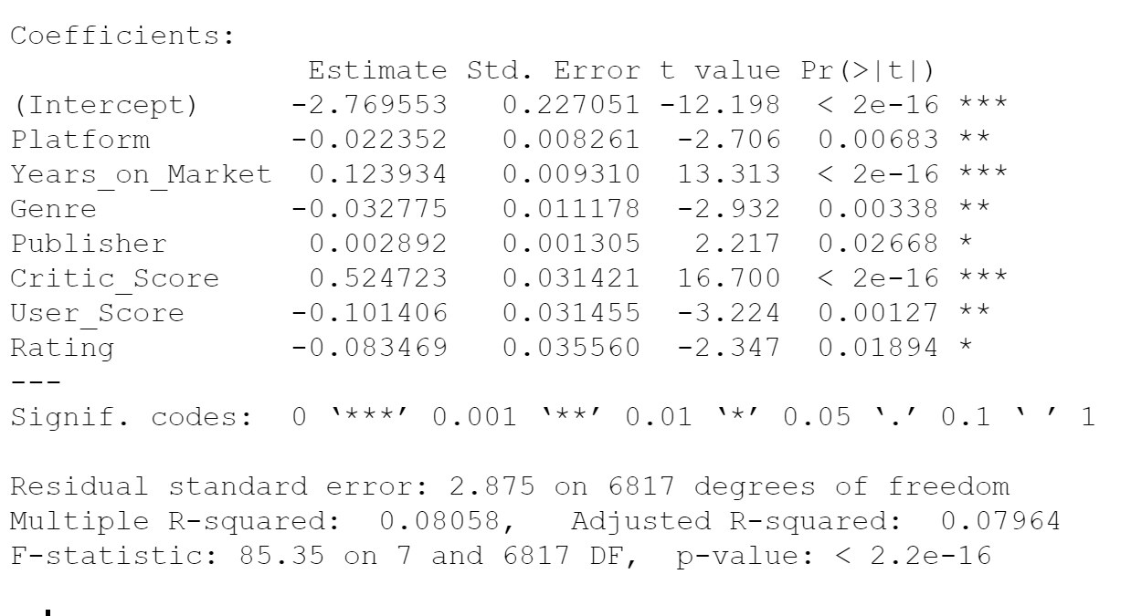
Candidate Features & Correlation

Slide 10


Predictive Regression Models
Modeling Global Sales with Linear Regression
Modeling Global Sales with XGBoost

Slide 11
Improving Model Performance
PROBLEM:
Initial Data set = too much for linear regression
SOLUTION:
Narrow the data set = focus on most profitable regions and genres
N. American Region
Focus on "Action" and "Sports" genres

Slide 12
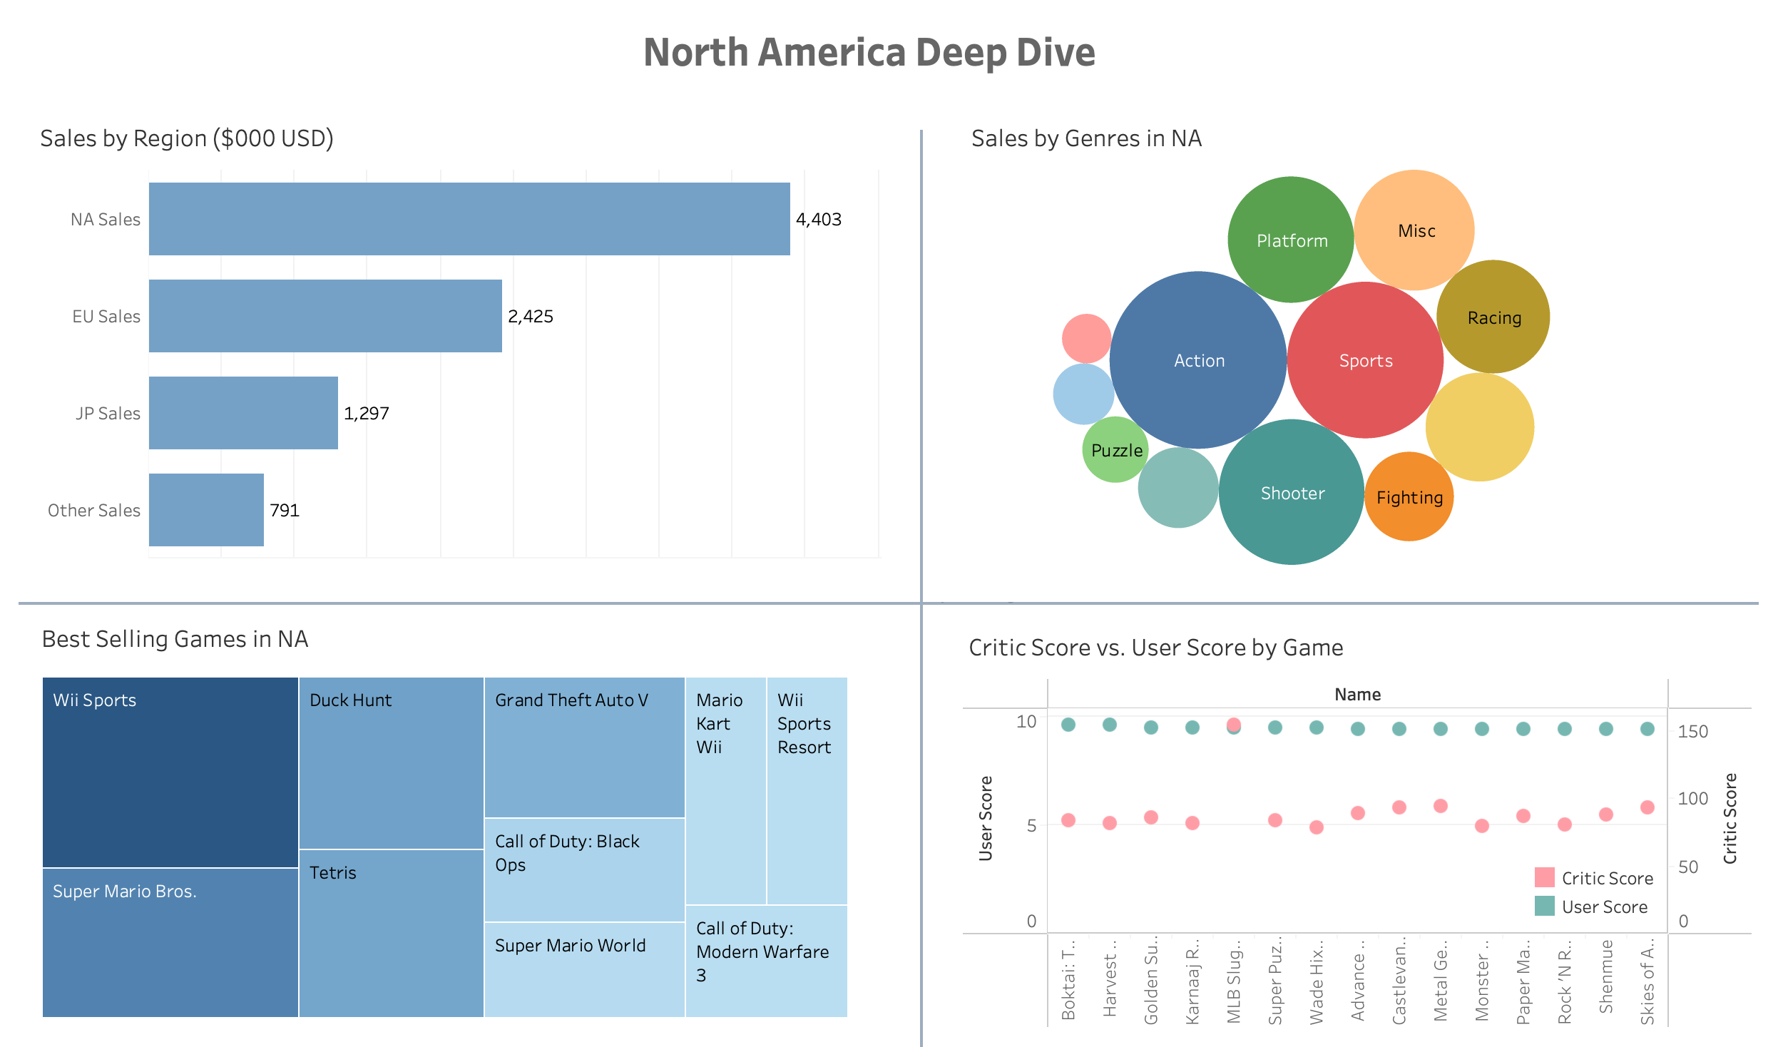

Slide 13



Model Improvement and Results
XGBRegressor: North America All Genres
XGBRegressor: North America Action Genre
XGBRegressor: North America Sports Genre

Slide 14
Further Improvements & Exploration
For Global Sales Model Improvement
Use loop to discover 'ideal' hyperparameters for XGBoost Model
Continue Genre by Genre Analysis for Each Global Region

Slide 15
Summary of Findings
XGBoost models > linear regression models
Models predicted global sales poorly
Models predicting regional sales for specific genres performed well
Business value: Can predict success of games for specific regions & genres

Slide 16

Thank You

